Slide 1
Fayette County Foundation Nonprofit Meet-Up

Slide 2
General tips on disability awareness
Speak directly to the person with a disability, not to a someone with them or their interpreter.
When you offer assistance wait for the individual to respond. Do not make assumptions, listen to and respect the instructions, along with the individuals wishes.
Don’t overlook hiring and/or accepting volunteers and interns with disabilities.

Slide 3
Be at eye level with a person who uses a wheelchair. You can do this by simply having a seat in a chair by them.
Do not hang on, hold on, or push a wheelchair without getting permission to do so. Their wheelchair is an extension of the persons body.
Be patient and do not try to guess or speak for a person who has a disability in the area of communication.
Keep your hands away from your face when speaking with a person who has a disability in the area of hearing.
More Tips
on
disability awareness

Slide 4
Asking questions
Kids who are not allowed to ask questions become adults who stare.

Slide 5
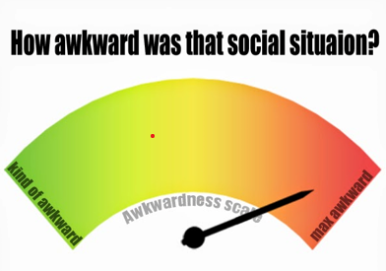
How to work through awkward situations
Model the correct etiquette.
Ask them to please not use that word around you and EXPLAIN WHY.
Be willing to have a conversation about it and why it is important.
Provide alternate words to replace the word that was used.

Slide 6
Steps to having an inclusive event
Make sure that your Website, Social Media, and other outlets are accessible to people with disabilities
Low Vision /Hearing Loss
Have a set policy on how to provide accommodations, and how to request accommodations in highly noticeable locations.
For Example
Individuals with disabilities, who would like to attend this event, please contact [insert event sponsor’s name and phone #] regarding any special accommodation needs. It is requested that individuals requiring auxiliary aids and alternative format materials notify the event sponsor at least [INSERT NUMBER] working days in advance. Every reasonable effort will be made to provide reasonable accommodations in an effective and timely manner.

Slide 7
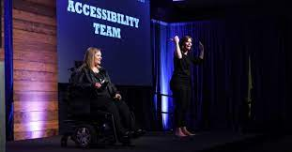
Include people with disabilities in photos/advertisements.
Do an event for disability awareness month
Ensure that people with disabilities are considered in your emergency preparedness plan

Slide 8
Easy Steps to take to ensure that your website is accessible to those with disabilities

Slide 9
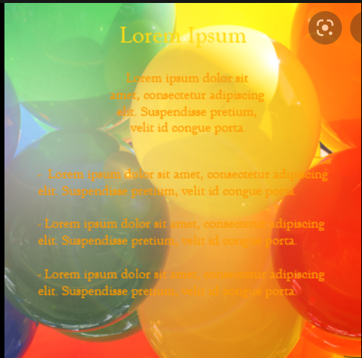
Do not place text over the top of photos
https://www.gm.com/
Do this instead
Make sure that you have good levels of contrast
Don’t do this
Do this instead

Slide 10
Something
to think
about

Slide 11
The Independent Living Center of Eastern Indiana
We have served over 370 people in Fayette County.
All of our services are at no cost to our Consumers (we are your Tax Dollars at work ☺)
We can help with:
Ramps
Getting back home from Nursing care/hospital stays
Education plans
Skills of Daily Living
Assistive Technology
So much more…

Slide 12
ILCEIN
Traci Taylor
Director of Programs and Services
(765) 939-9226
Ext 102
Rebecca Hinners
Service Coordinator
(Fayette, Rush, Franklin, and Decatur Counties
(765) 939-9226
Ext 201

